Slide 1
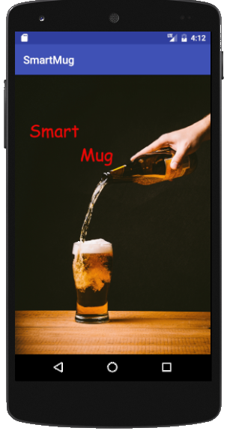
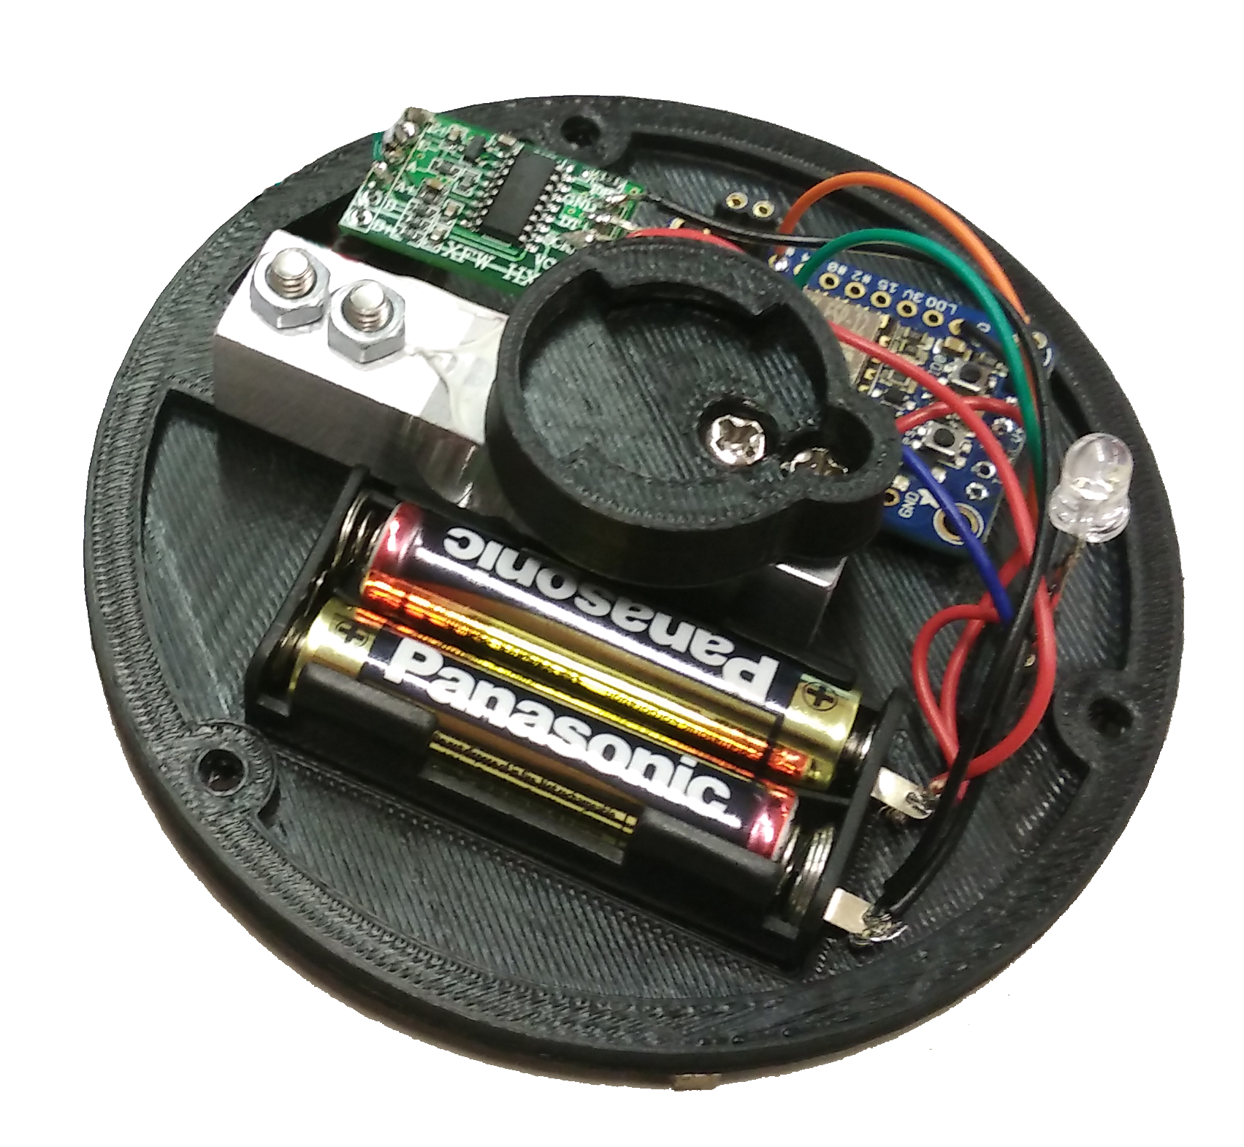
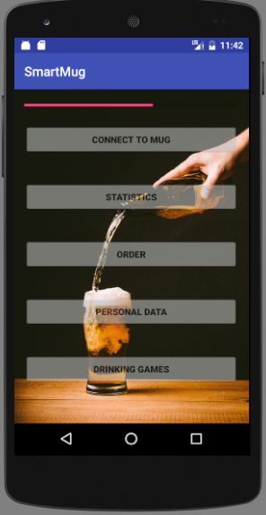
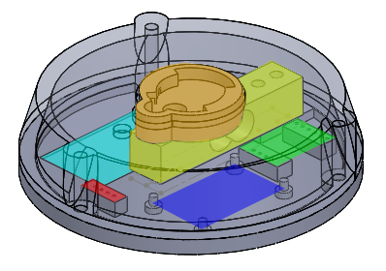
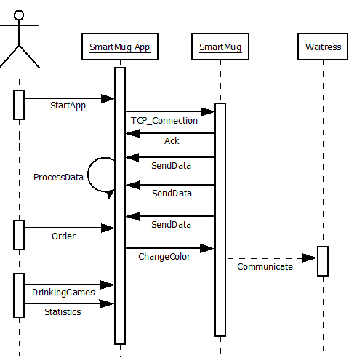


SmartMug The smart way of drinking
Martin Dold, Larraitz Orio,
Gürkan Karacocuk, Dennis Tritschler
Architecture
Andriod App: Connects to the SmartMug
Wifi access: Wireless Communication
Mug: Standard Mug
Smart mug: Extension to make your mug smart
Functions
Connection to mug via bar code reading
Liquid level sensing via weight (HX711 circuit)
Drinking statistic analysis via app
Interactive drinking games via app
Waitress communication by changing mug color
SmartMug
SmartMug App
HX711
Bayonet mount
Load cell
ESP8266 module
Glass fill level
Display statistics
e.g. Blood alcohol level
Batteries
RGB-LED
Connect to SmartMug
via Bar Code or by
entering the IP Adress
Case
Enter your personal Data
for some statistics
Order via SmartMug
Play drinking games
Connection
SmartMug Protocol
TCP/IP → Wireless LAN according to
IEEE802.11b/g standard
Multicast DNS:
Service name: smartmug
Service type: _smartmug._tcp
Sequence diagram
Tag 1byte | Length 1byte | Value n bytes | End of Frame 1 byte
Outlook
- Connection to the barkeeper → Live data for the barkeeper, direct re-order function
- Payment via app
- Capacitive measurement instead of weight
- Connection between taps and SmartMug for automated and exact meassuring of the filling level
More Details under:
https://github.com/martin-dold/smartMug

